Slide 1




SMART SWITCH BOARD WIRELESS SWITCH BOARD USING BLUETOOTH
TEAM-7
PHASE-3 REVIEW
01

Slide 2
STUDENT DETAILS
SL.NO | NAME OF STUDENT | REGISTER NUMBER | ROLE
1. | M.V.N AMRUTH SAI | 99220040641 | PRESENTER AND PROGRAM CODE
2. | G.VEERA REDDY | 99220040507 | COLLECTING COMPONENTS
3. | M. RAMA YOGI REDDY | 99220040627 | RELAY TO SWITCHBOARD CONNECTION
4. | M. KRISHNA KUMAR REDDY | 99220040635 | ARDUINO UNO TO RELAY CONNECTION
5. | Y.B.V. AKASH | 99220040787 | ARDUINO UNO TO BLUTOOTH MODULE CONNECTION
02

Slide 3
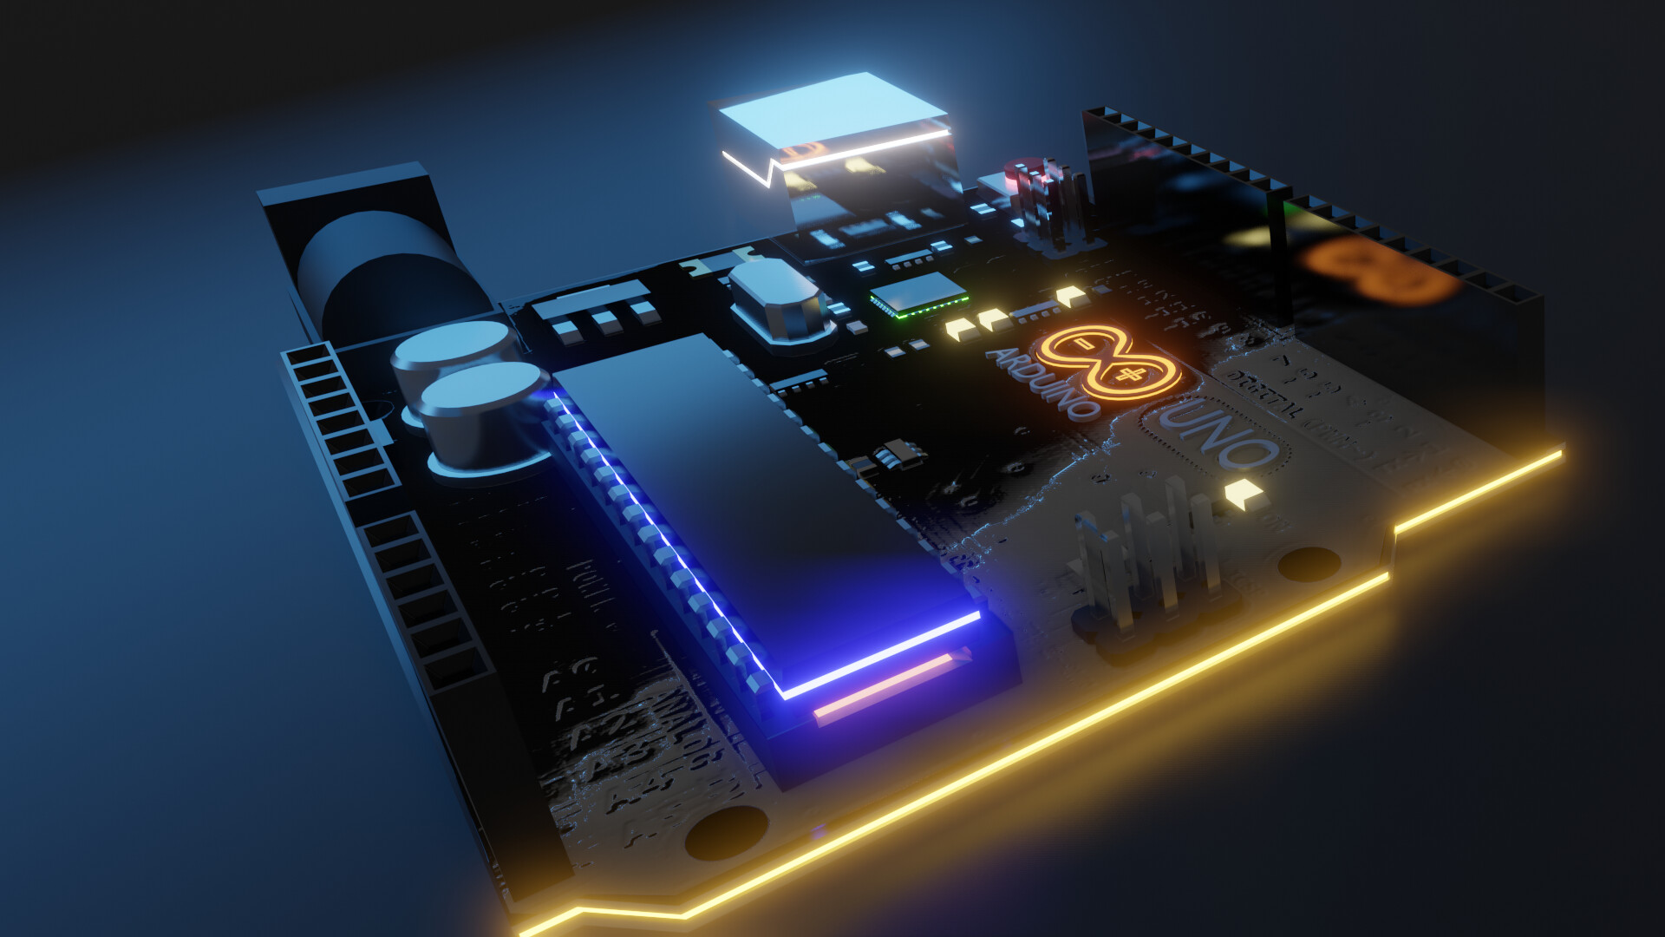
TABLE OF CONTENTS
INTRODUCTION
OBJECTIVES
COMPONENTS REQUIRED
4. METHODOLOGY
5. SUSTAINABLE GOALS
6. IMPLEMENTATION
7. REFERENCES
8. LITERATURE REVIEW
03

Slide 4
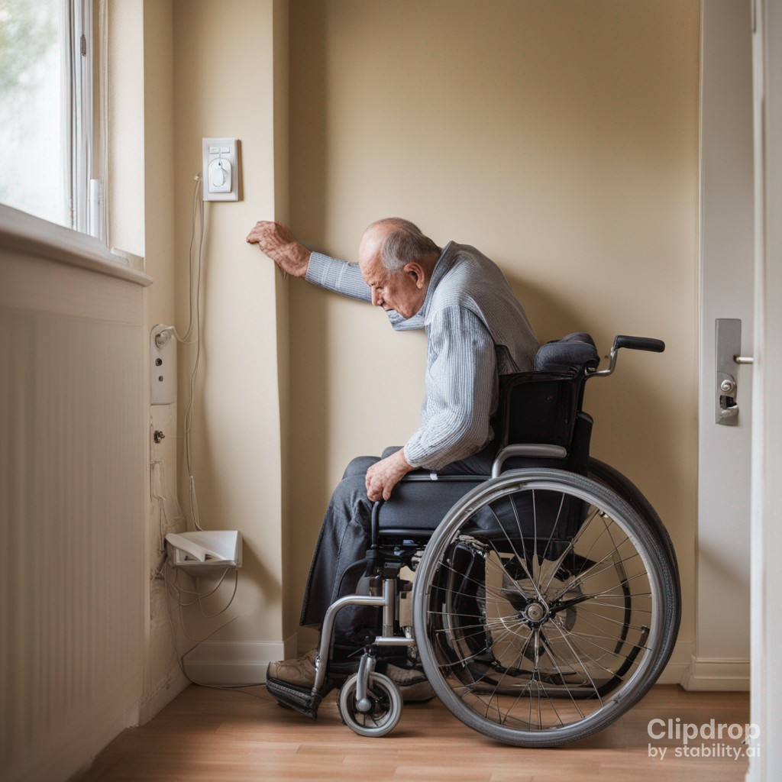
PROBLEMS OBSERVED IN PHYSICAL SWITCHBOARD
People who are physically handicapped, old aged and people who are lazy to move from their comfort zone in order to on the switches on the physical switch board may find some difficulties. The switchboard is not accessible at all times. People may prone to electric shock when they touch switches with wet hands
04

Slide 5
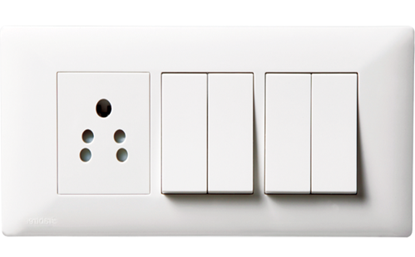
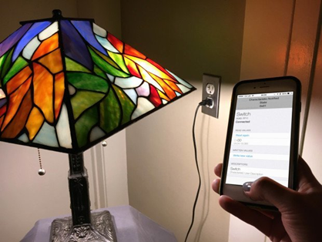
ABSTRACT
Our project aims to create a wireless switchboard system using a Bluetooth module and relay in conjunction with an Arduino Uno. This system offers a user-friendly and convenient way to remotely control electrical appliances using mobile phone. The project provides a cost-effective solution that can be easily implemented and understood by all.
PHYSICAL SWITCHBOARD
SMART SWITCHBOARD
05

Slide 6
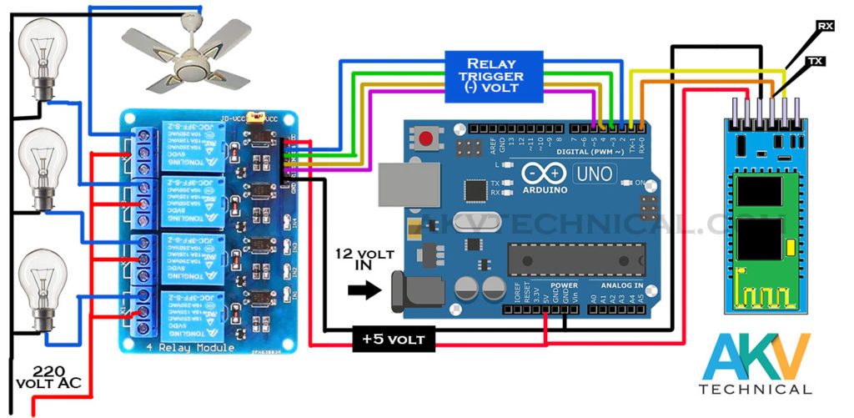
INTRODUCTION TO SMART SWITCH BOARD
Wireless switchboard using Bluetooth and Arduino UNO is an innovative solution that allows users to control various electrical appliances wirelessly through bluetooth. It eliminates the need for traditional wired connections and offers greater flexibility and convenience.
06

Slide 7
OBJECTIVES
To design and develop a wireless switchboard system that allows users to remotely control electrical appliances via a smartphone using bluetooth.
To make the switchboard accessible at all times using mobile.
To help physically challenged people and old age people to access switch board with the help of smart phones.
To implement the project in remote areas (like villages) as the internet connectivity at those places is not stable.
07

Slide 8
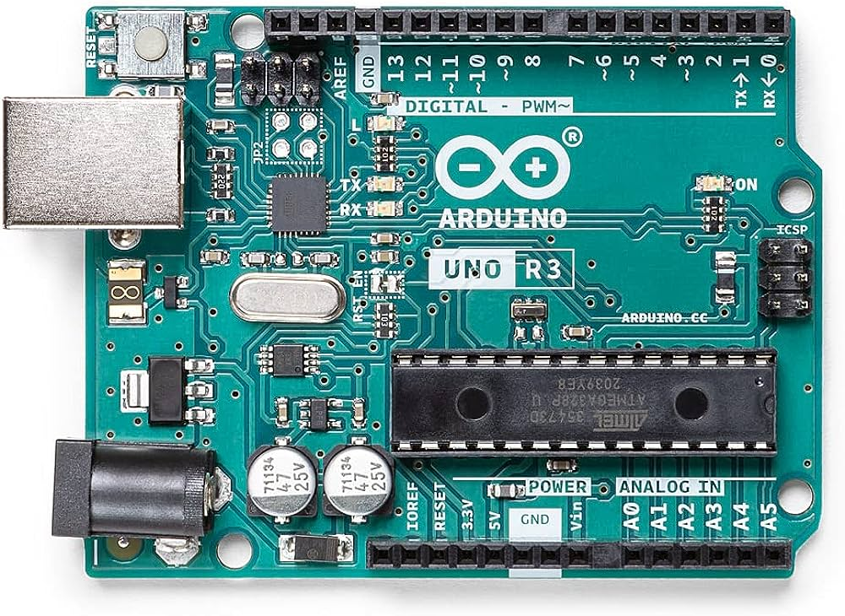
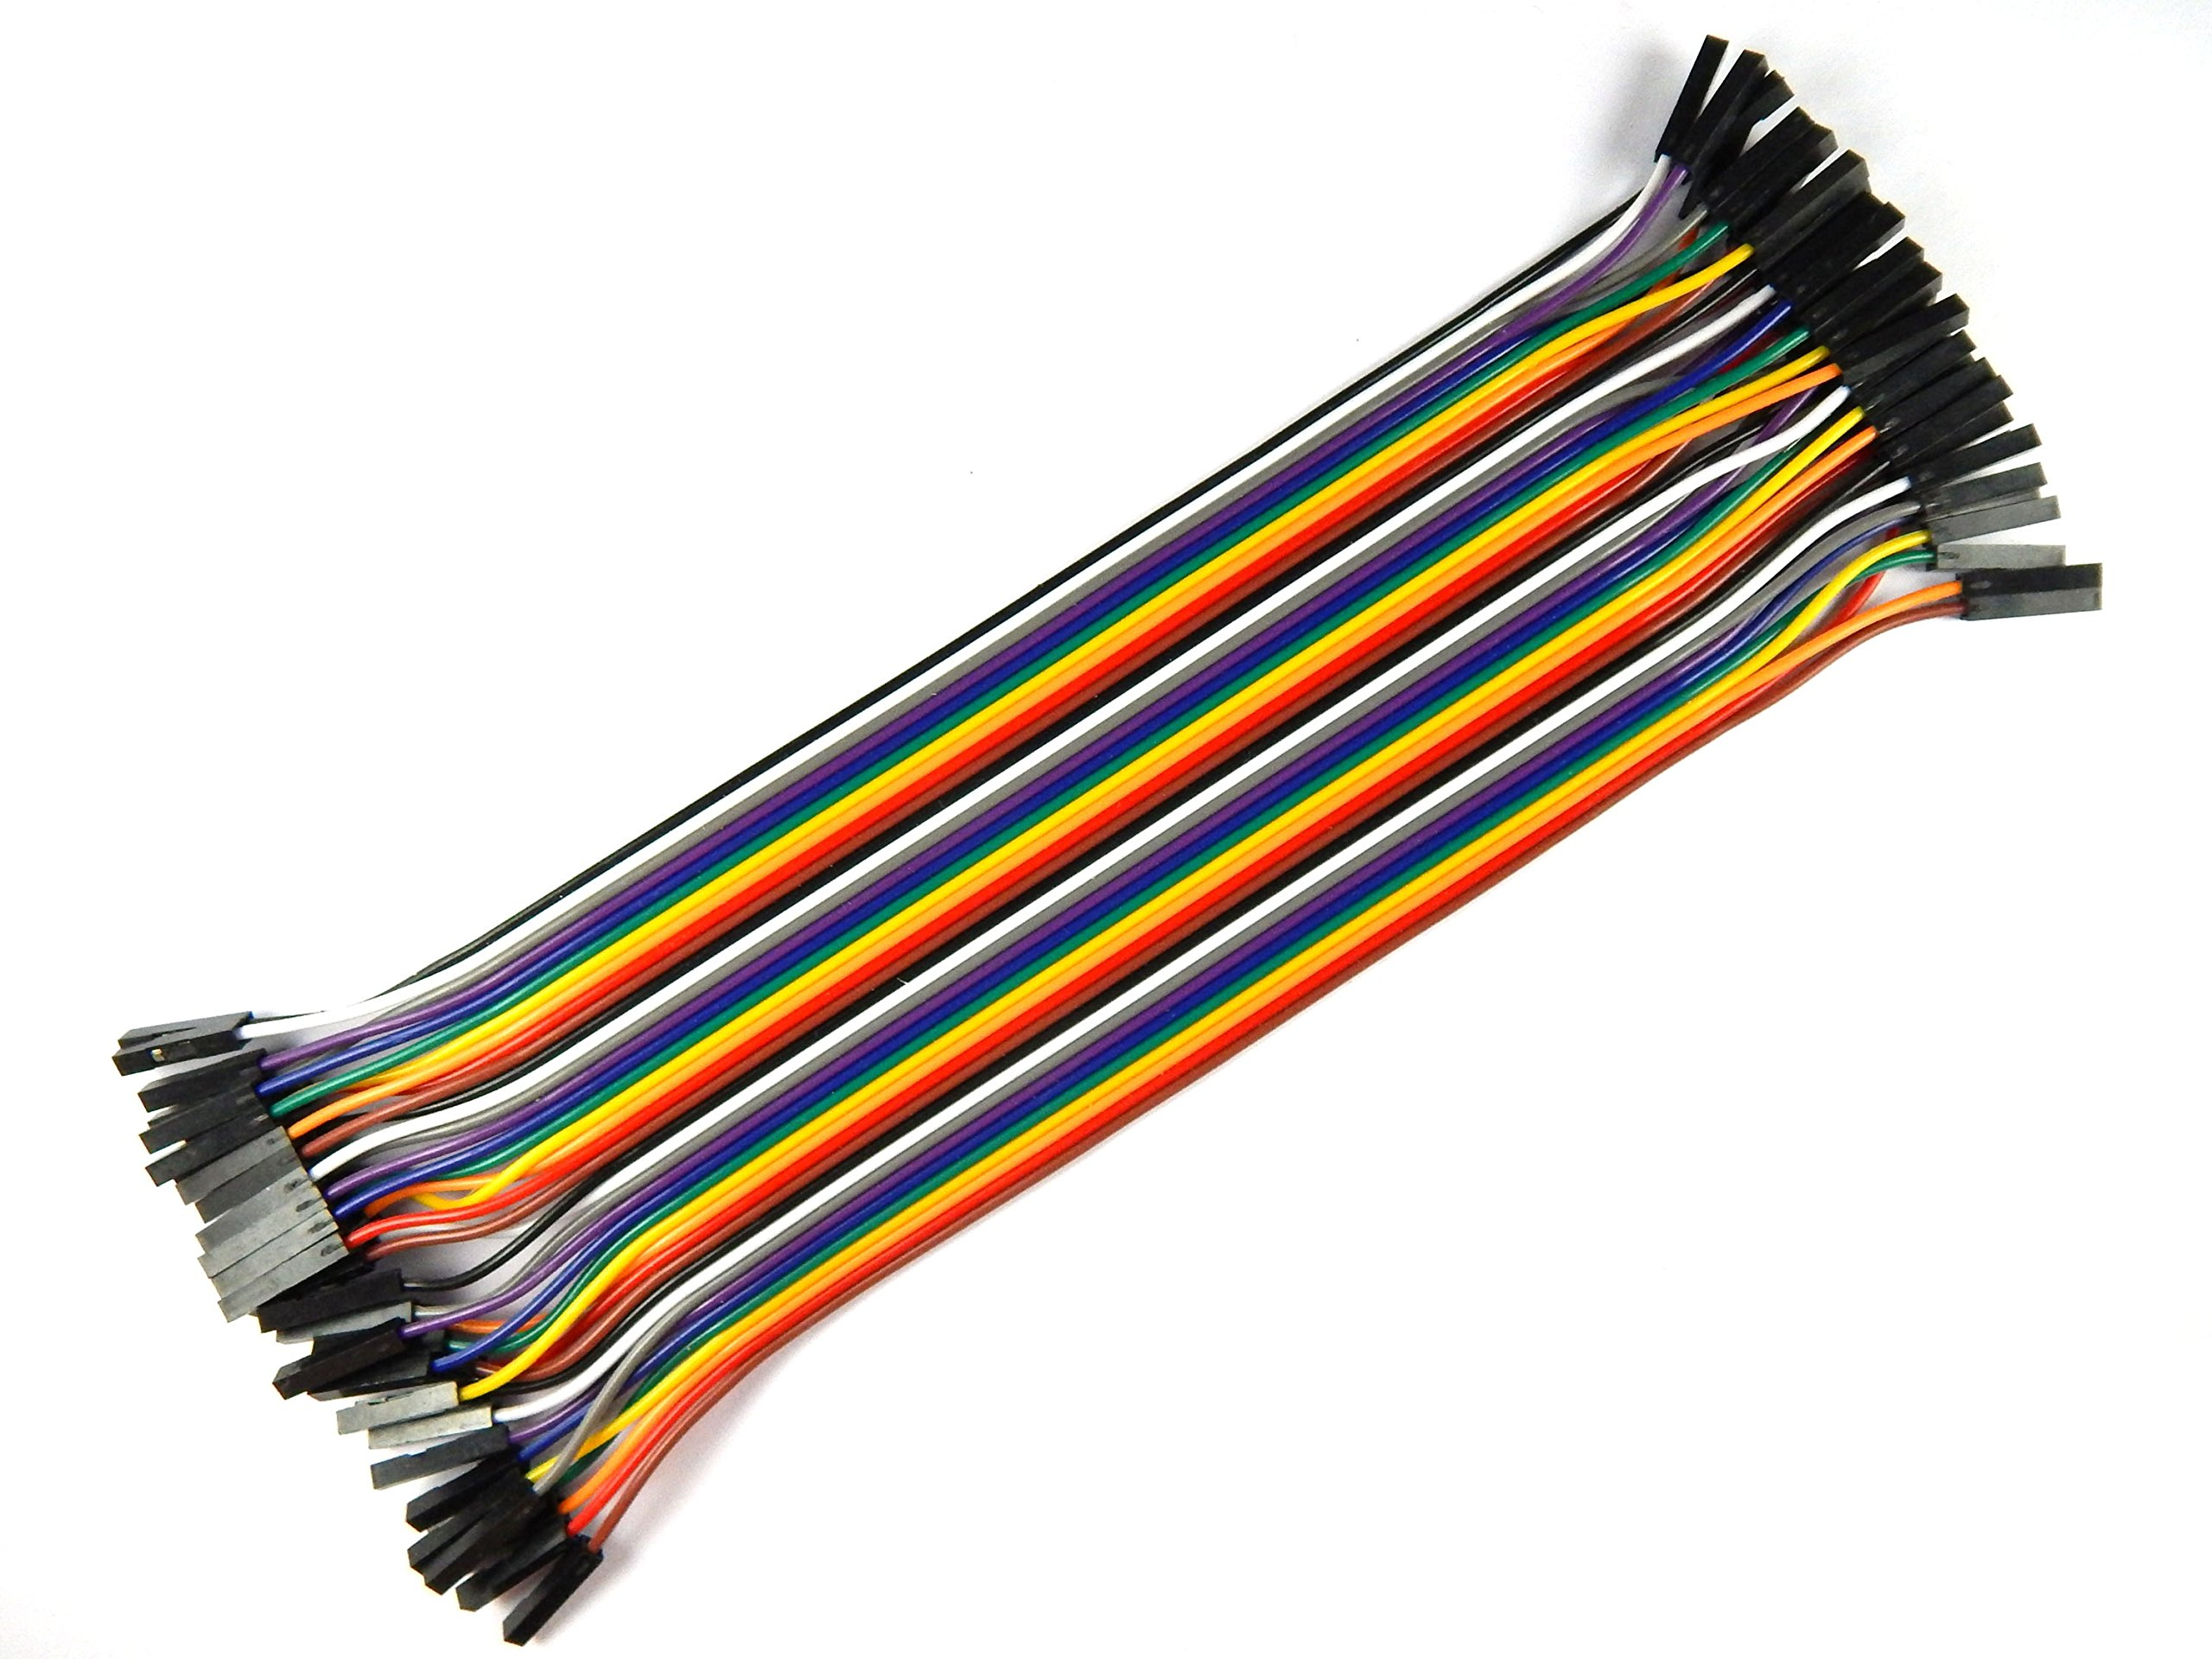
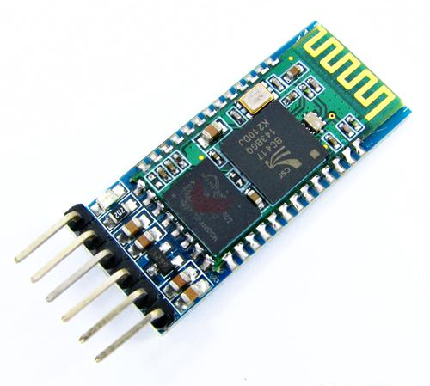
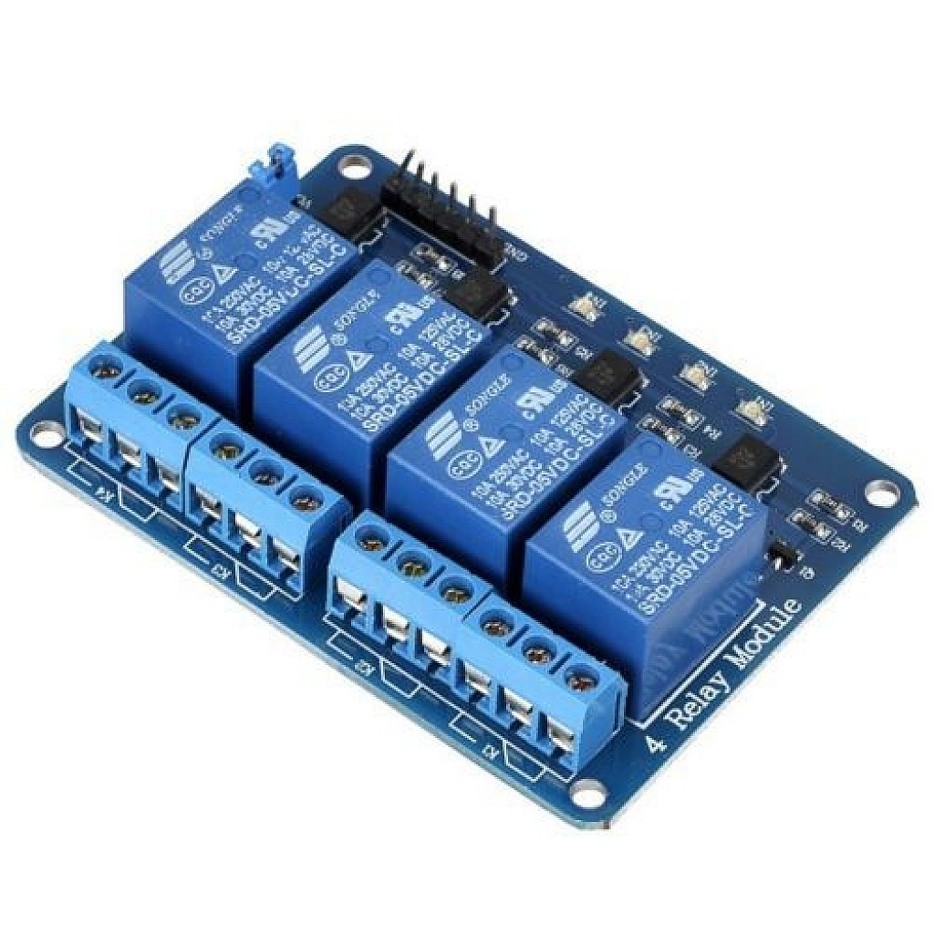
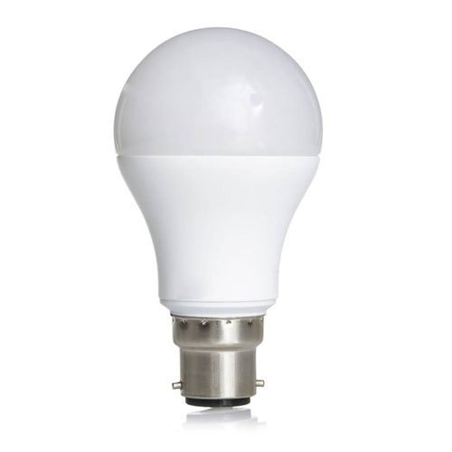
COMPONENTS REQUIRED
Arduino UNO Bluetooth Module HC-05 4-Channel Relay Module Jumper Wires Connecting Wires Electrical Loads (lights, charger etc) Bluetooth based Application for mobile
08

Slide 9
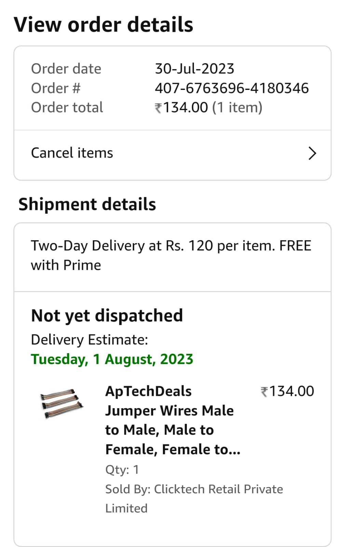
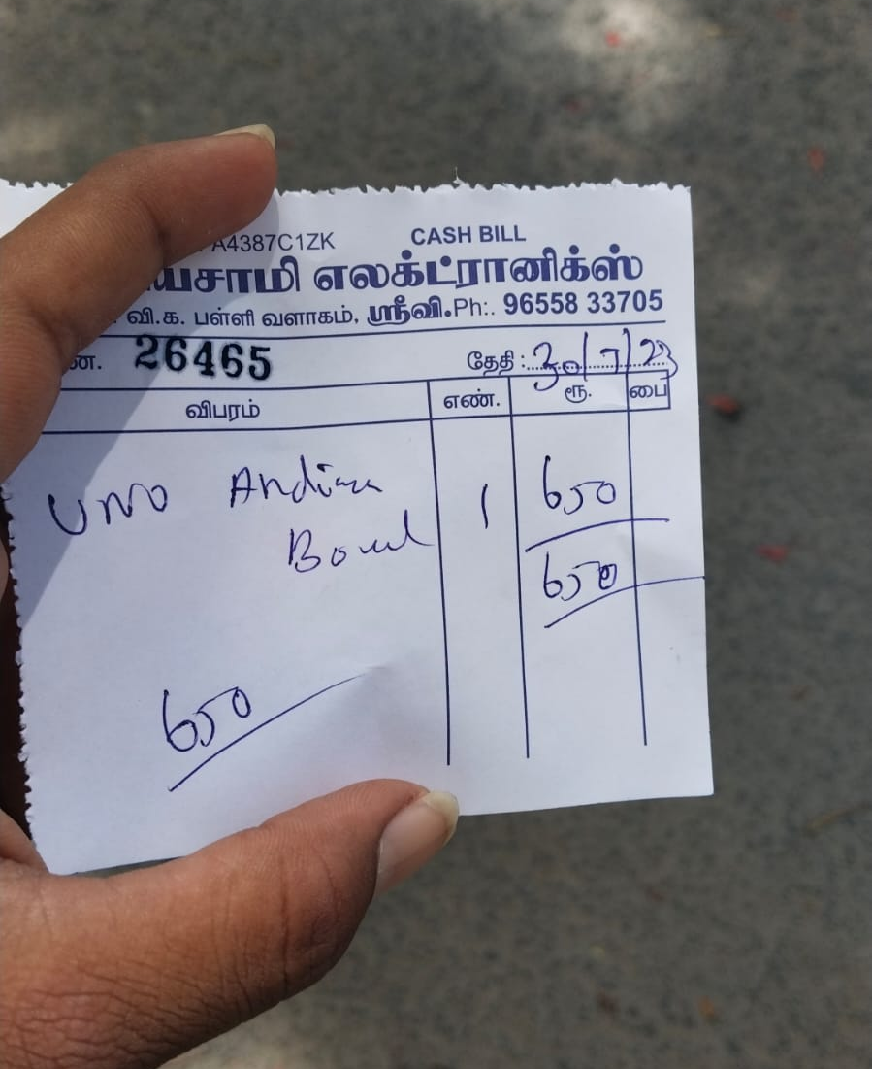
COST OF COMPONENETS
SNO | COMPONENT | SPECIFICATION | NUMBER OF COMPONENTS | COST
1. | BLUETOOTH MODULE | HC-05 | 1 | 250/-
2. | ARDUINO | UNO | 1 | 650/-
3. | 4-CHANNEL RELAY | JQC3F-5VDC-C | 1 | 300/-
4. | JUMPER WIRES | MALE TO FEMALE, MALE TO MALE, FEMALE TO FEMALE | 30 | 134/-
5. | CONNECTING WIRES | 2 METRE | 1 | 30/-
6. | SWITCH BOARD SOCKET | - | 1 | 110/-
TOTAL - 1474/-
09

Slide 10
PROJECT PLAN
SL.NO | TIME PERIOD | GOAL
1. | Week 1-2 | Identifying the problem
2. | Week 3-4 | Learning about different sensors or modules required to solve the problem
3. | Week 5 | Procuring the components
4. | Week 6 | Making connections and program the code for the problem
5. | Week 7 | Analyzing and testing the device.
6. | Week 8 | Implementation or Application
10

Slide 11
METHODOLOGY
The Arduino Uno is programmed to receive commands from the smartphone via Bluetooth. In order to perform this we need to install a Bluetooth based application which has “ON” and “OFF” buttons to turn on or turn off the circuits. When a command is received, the Arduino processes it and controls the corresponding relay module. The relay module, in turn, controls the electrical appliances connected to it, either by switching them on or off.
11

Slide 12
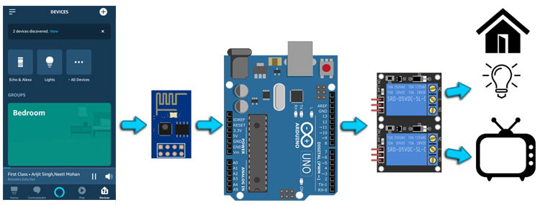

BLOCK DIAGRAM
MOBILE APPLICATION
BLUETOOTH HC-05
ARDUINO
4-CHANNEL RELAY
ELECTRIC
LOADS
12

Slide 13
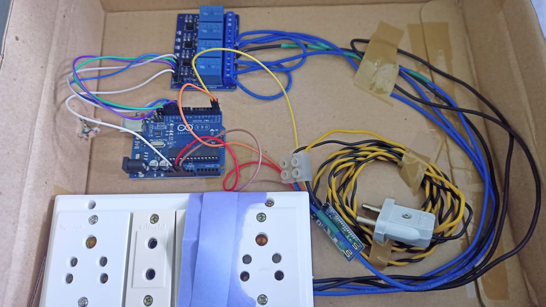
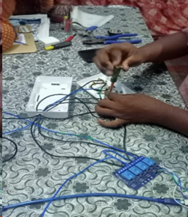
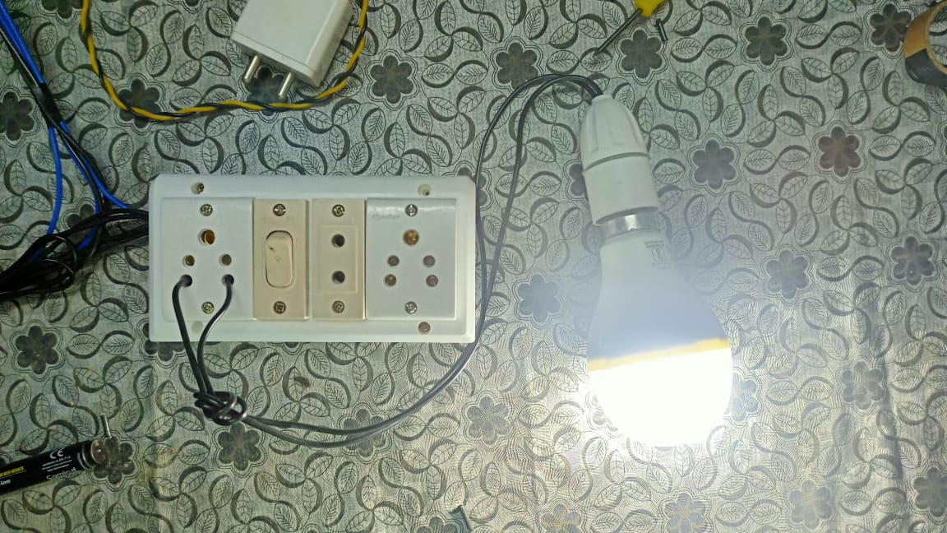
PROTOTYPE AND IMPLEMENTATION
13

Slide 14
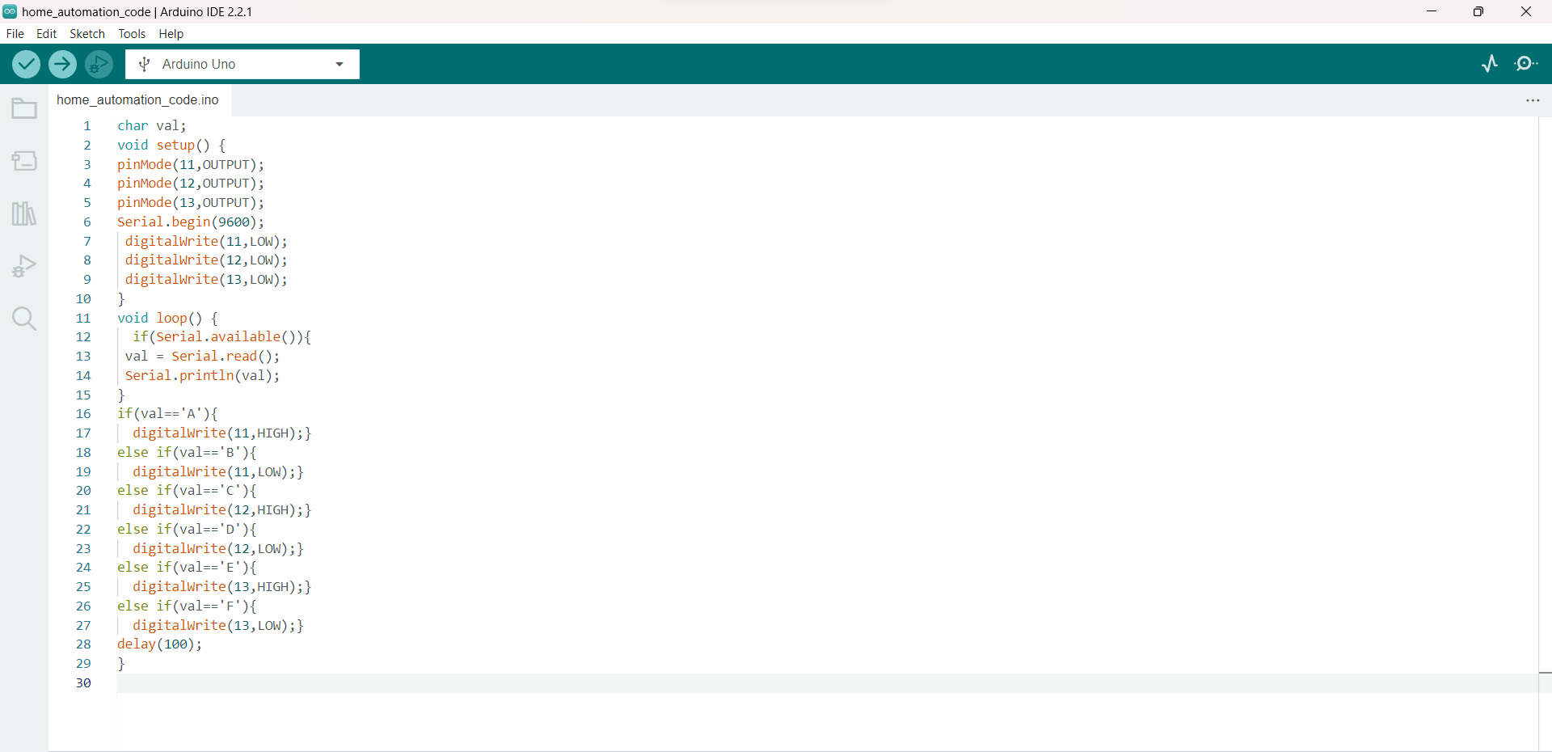
PROGRAM
14

Slide 15

SUSTAINABLE DEVELOPMENT GOALS
Sustainable Cities and Communities: The wireless switchboard can be integrated into smart city initiatives, allowing for centralized control of electrical appliances. Home automation system enhance the quality of life by making homes more comfortable, convenient, and secure which in turn contributes to sustainable urban development.
15

Slide 16
ADVANTAGES
The main advantage of wireless switch board is that it does not require internet connection. It will help to the people who live in remote areas like villages since the network is very low at those areas Some mobiles which does not have IR blaster (like Xiaomi, Poco, Mi) can also operate electrical devices simply connecting through Bluetooth. It is accessible and also we can operate appliances anywhere at the range of Bluetooth signal. We can add security features in order to access the switch board.
16

Slide 17
DISADVANTAGES
Bluetooth technology typically has a limited range of around 10 meters. Users need to be within this range to control the switchboard effectively. This can be a limitation in larger homes or commercial settings. The wireless switchboard using Bluetooth and Arduino Uno requires a compatible smartphone or Bluetooth-enabled device to control it. Compatibility issues may arise if the controlling device does not support the required Bluetooth version or protocols.
17

Slide 18
CHALLENGES
The integration of both a WiFi module and a Bluetooth module with an Arduino Uno presents a technical challenge for connecting the Arduino board to the cloud for monitoring. While the Arduino Uno has limited hardware serial ports, typically one for USB communication and one for hardware serial, it's essential to address this challenge in the future to find a solution to this problem in order to create a seamless IoT cloud connection for wireless switchboard project.
18

Slide 19
REFERENCES
[1] The official Bluetooth website from BluetoothSIG: http://www.bluetooth.com [2] Neng- Shiang Liang; Li-Chen Fu; Chao-Lin Wu. “An integrated, flexible, and non-Internet-based control architecture for home automation system at home”. Proceedings ICRA `02. IEEE International Conference on Robotics and Automation, Vol. 2, pp.1101-1106, 2012 [3] K. Mandula, R. Parupalli, C. A. S. Murty, E. Magesh and R. Lunagariya, "Mobile based home automation using Internet of Things(loT)," 2015 International Conference on Control, Instrumentation, Communication and Computational Technologies (ICcrCCT), Kumaracoil, 2015, pp. 340-343.
19

Slide 20
REFERENCES
[4] D. Chowdhry, R. Paranjape and P. Laforge, "Smart home automation system for intrusion detection," 2015 IEEE 14th Canadian Workshop on information Theory (CWIT), St. John's, NL, 2015, pp. 75-78. [5] N. Skeledzija, J. C. Edin, V. Bachler, H. N. Vucemilo, H. Dzapo , "Smart home automation system for energy efficient housing", 37th International Convention on Information and Communication Technology, Electronics and Microelectronics (MIPRO), 2014, pp. 166-171. [6] R. K. Kodali, V. Jain, S. Bose and L. Boppana, "loT based smart security and home automation system," 2016 Tnternational Conference on Computing, Communication and Automation (ICCCA), Noida, 2016, pp. 1286-1289.
20

Slide 21
LITERATURE REVIEW
1. “Smart Home Automation System Using Bluetooth Technology”,Muhammad Asadullah 978-1- 5090-3310-2/17/$3\.00 ©2017 IEEE It is a home automation system developed using Arduino board, Bluetooth module HC-06, smartphones. Bluetooth has lower bandwidth and shorter range. 2. “Smart Home Automation and Security System using Arduino”, Siddharth Wadhwani1, Uday Singh2, Prakarsh Singh3, Shraddha Dwivedi4 Volume: 05 Issue: 02 | Feb-2018 It is a home automation system using Arduino Uno board and Wireless fidelity technology. It accepts command only through clicks
21

Slide 22
LITERATURE REVIEW
BLUETOOTH BASED WIRELESS HOME AUTOMATION SYSTEM USING ARDUINO UNO: B.Murali Krishna, V.Narasimha Nayak, K.Ravi Kishore Reddy, B.Rakesh, P.Manoj Kumar and N.Sandhya International Journal of Engineering and Techniques - Volume 4 Issue 1, Jan – Feb 2018 [2] they presented a paper on the Bluetooth based Wireless Home automation system using Arduino UNO. They primarily focused on Bluetooth technology. With the help of the Bluetooth module (HC-05) and Android Phone, they control the home appliances, which all connected to FPGA board. Thus, they have mentioned the advantages of the home automation, which not only reduces the human efforts, but it is also energy efficient and time saving. Moreover, they have included that it is also help to the handicapped and old aged people to control the home appliance without any difficulties. We need module so that the range will be high as well as it can operate in different frequencies. This drawback is overcome by our model.Wi-Fi based networks work at 2.4, 3.6 and 5 GHz. In addition, it can extend up to range 100m.
22

Slide 23
THANK YOU

